Slide 1
Component 3: Exercise Debrief
February 22, 2017

Slide 2
Case Study Format and Purpose
Provide overview of civil design issues related to Intelligent Transportation Systems (ITS)
Explore approaches to integrating ITS components into field settings
Application: Design camera installation to support deployment of ITS for a major university trip generator – football game
Notes:
Purpose of Slide: Introduce purpose of the case study.
Key Message: This case study provides an overview of civil design supporting ITS.
Time on Chart: 1 minute
Suggested Comments: This case study will introduce you to civil design issues used to support Intelligent Transportation Systems (ITS) deployments. The support includes existing infrastructure, structures, utilities, communication, and security. The Case Study assumes an understanding of ITS concepts. There are 3 components to this case study. This discussion presents a possible solution for core aspects of the exercise and presents considerations that may revise the design if realized.
Transition:
Interactivity:
Additional Resources:

Slide 3
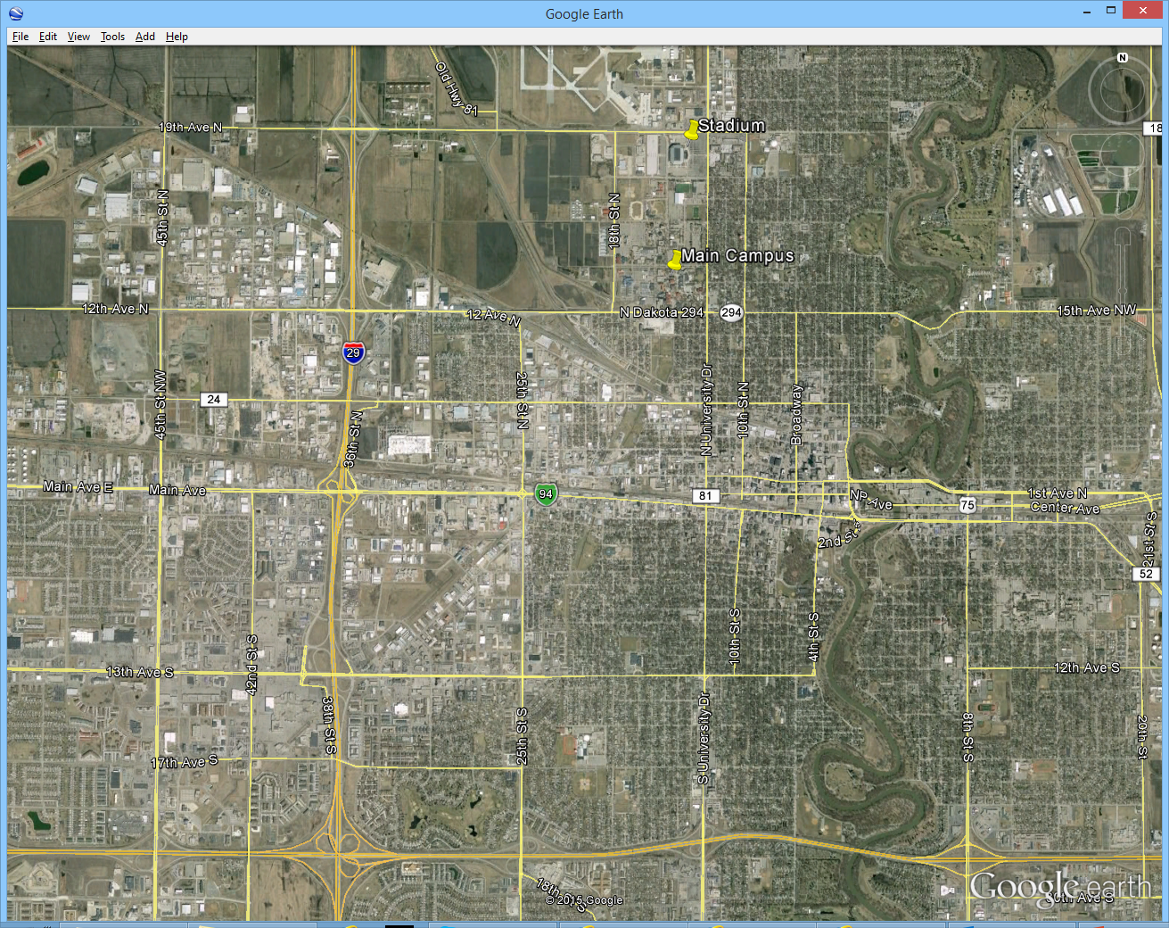
Representative Case Study
Stadium
Major
Arterial
Campus
Freeway
Interchange
Town
Center
Primary
Congestion
Secondary
Congestion
Notes:
Purpose of Slide: Present setting for the case study.
Key Message: The Case Study is a realistic scenario.
Time on Chart: 1 minute
Suggested Comments: As a representative scenario, consider a Midwestern university in a medium-sized city. The university team plays home football games at a domed stadium managed by a regional authority and shared with local events such as concerts, conventions, and community events. University football games represent the largest crowds that the stadium draws. The stadium is a quarter mile from the North edge of the campus and about a mile from the South edge. There are other university facilities up to a few miles away. For the purposes of the case study, the major arterial for consideration is 12th Avenue North, which intersects the Interstate about two miles from campus and has 7 signalized intersections to reach campus.
Transition:
Interactivity:
Additional Resources:
The image is take from Google Earth.

Slide 4
Exercise Activities
Siting
Task 1: Siting
Identify locations where camera can fulfill functions
Consider relative merits of locations
Task 2: Power
Utility coordination
Tie to infrastructure or not
Task 3: Communication
Own versus lease
Utility coordination
Task 4: Structures
Jurisdictional standards on structures
Use of existing structures
Task 5: Integration and Testing
Determine how project completion will be determined
Power
Comm.
Structures
Testing & Integration
Notes:
Purpose of Slide: Describe the exercise tasks.
Key Message: The exercise will consist of specific tasks which will be discussed in this presentation.
Time on Chart: 1 minute
Suggested Comments: The exercise consisted of 5 tasks as listed on this slide. Potential solutions will be presented and available for discussion. It should be emphasized that no one solution is best for all situations. Students should be encouraged to present their solutions along with rationale and analysis to support them.
Transition:
Interactivity:
Additional Resources:

Slide 5
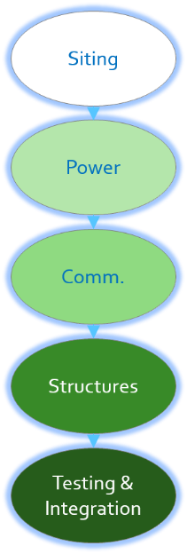
Camera Siting
Coverage of roadways of interest
Costs
Considered three sites
South of Arterial
North of Arterial, near NB Off Ramp
North of Arterial, on existing sign structure
Notes:
Purpose of Slide: Review major considerations in selection of camera
Key Message: Device selection is dependent on project needs.
Time on Chart: 1 minute
Suggested Comments: Siting and civil design for ITS elements depend on a number of factors, including the horizontal and vertical curvature of the roadway near the device. Many ITS devices require line of site between roadside devices and portions of the roadway, with different types of devices differing in distance required. In the case of cameras, siting mandates visibility of the traveled way along with shoulders and medians. A frequent requirement is for continuous coverage with a minimum number of sites to minimize costs. Camera sites are frequently located on the outside of a horizontal curve near where the tangent sections would intersect and at the crest of the hill for areas with vertical curvature. Additionally, vegetation can be a driver for camera siting, including in medians. Tree trimming and removal is frequently not allowed subject to esthetic and environmental regulations. Note: Site line surveys should be done during the summer to accommodate the full extent of the vegetative blockages. In our example, the roadway has little curvature either horizontally or vertically.
Transition: The following slides present considerations for the siting alternatives, a recommended solution for this exercise, and suggested answers for discussion questions.
Interactivity:
Additional Resources:

Slide 6
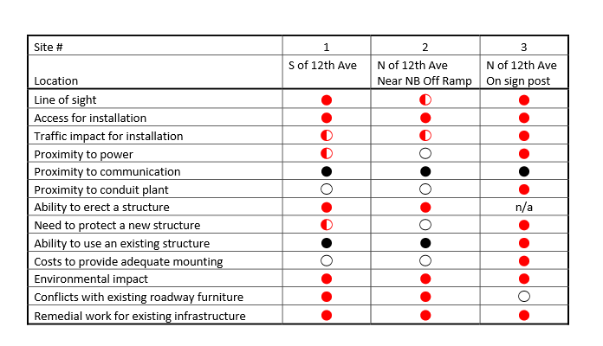
Camera Siting
Notes:
Purpose of Slide: Present major characteristics of candidate camera sites.
Key Message: Device selection is dependent on project needs.
Time on Chart: 1 minute
Suggested Comments: Each potential site has strong points and weak points. Each characteristic should be considered to arrive at a good decision for a specific set of project requirements.
Transition:
Interactivity:
Additional Resources:

Slide 7
Camera Siting
Use of existing sign structure (Site 3) is preferred technically
State requires coordination
Responsibility for non-state equipment installation
Structural analysis for addition of cabinet and camera
With delay risks, installation of new poles South of arterial (Site 1) is selected
Notes:
Purpose of Slide: Present major considerations in selection of camera
Key Message: Device selection is dependent on project needs.
Time on Chart: 1 minute
Suggested Comments: The considerations presented in the previous slide indicate that the mounting of the camera on the existing sign structure (Site 3) is the most advantageous. It should be emphasized that the relative weighting of the considerations is an assessment subject to project priorities. Evaluations may differ in preferences and resulting conclusions. In our example, the state has determined that reuse of sign structure by an agency other than the state Department of Transportation has liability implications and that no policy is in place to cover this situation. As a result, a policy will have to be developed, which may take from several months to several years. Additionally, the state policy is that all additional load placed on a structure requires review by a structural engineer. Therefore, deployment of new city equipment on the structure will not be allowed until both issues are addressed to the satisfaction of the state DOT. The project management has determined that the risk for delay with this requirements on the use of the structure is unacceptable for a project that is desired to be deployed in less than a year. As a result, the installation of new poles South of the arterial (Site 1) will be used as the preferred alternative for future planning.
Transition: The following two slides present potential answers for discussion questions.
Interactivity:
Additional Resources:

Slide 8
Camera Siting
How would the analysis of alternatives change if the area had an endangered species of mole?
Earthwork may be limited
Reuse of existing structures could be preferred
In this scenario, are locations for siting the camera other than the three considered attractive?
Sites considered are most advantageous
Locations outside of interchange show only one roadway clearly
Locations West of Interstate limit arterial coverage
Notes:
Purpose of Slide: Review the siting questions.
Key Message: Review the siting questions.
Time on Slide: 4 minutes
Suggested Comments:
Question 1:
The options that include earthwork would require significantly more detailed planning and may be rejected depending on the findings of the detailed planning. Plans would also require concurrence from additional agencies, at least including the State Department of Environmental Protection. Expected impacts include delays in planning approval, increased costs for design, and increased cost for construction. An advocacy group could also observe carefully, or even obstruct via demonstrations. Coordination with the State for use of the existing sign pole could become the most advantageous option to pursue
Question 2:
The issue being addressed in this project is event-related demand that occurs 5 – 10 times per year. The event site is to the East along the arterial, with the largest volume of data arriving from the South along the interstate. The ability to observe traffic is most valuable along these roadways. Placing the camera to the West of the interstate is less desirable, but locations with the ability to see both the arterial and freeway are acceptable. Placing the camera where only one of the roadways is visible would seriously compromise the benefit of the project.
Transition:
Interactivity: Ask class if they have any questions and encourage them to explain their answers.
Additional Resources:

Slide 9
Camera Siting
What locations should be considered if the State DOT revokes their agreement to allow the surveillance deployment to take place in the interchange right of way?
Moving East would limit Interstate coverage
Reallocation of funding to other project elements may be more beneficial
Notes:
Purpose of Slide: Review the siting questions.
Key Message: Review the siting questions.
Time on Slide: 2 minutes
Suggested Comments: Without access to the interchange, the ability to gain video images of freeway traffic is severely reduced. The impact of being off of the intersection right of way is increased due to the width of the interchange. Just East of the traffic signal for the Northbound off ramp would be able to see the off ramp clearly, even if the freeway was partially obstructed. Without access to the interchange right of way, my recommendation would be to reallocate the year one budget for this site to TMC design to progress that portion of the project. Surveillance of the freeway would be pursued via sharing of video images once the State implements cameras.
Transition:
Interactivity: Ask class if they have any questions and encourage them to explain their answers.
Additional Resources:

Slide 10
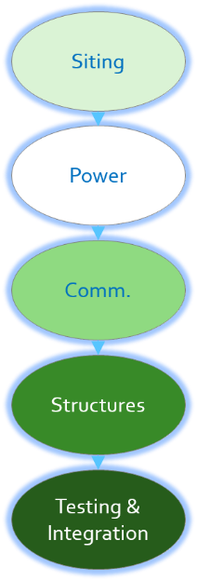
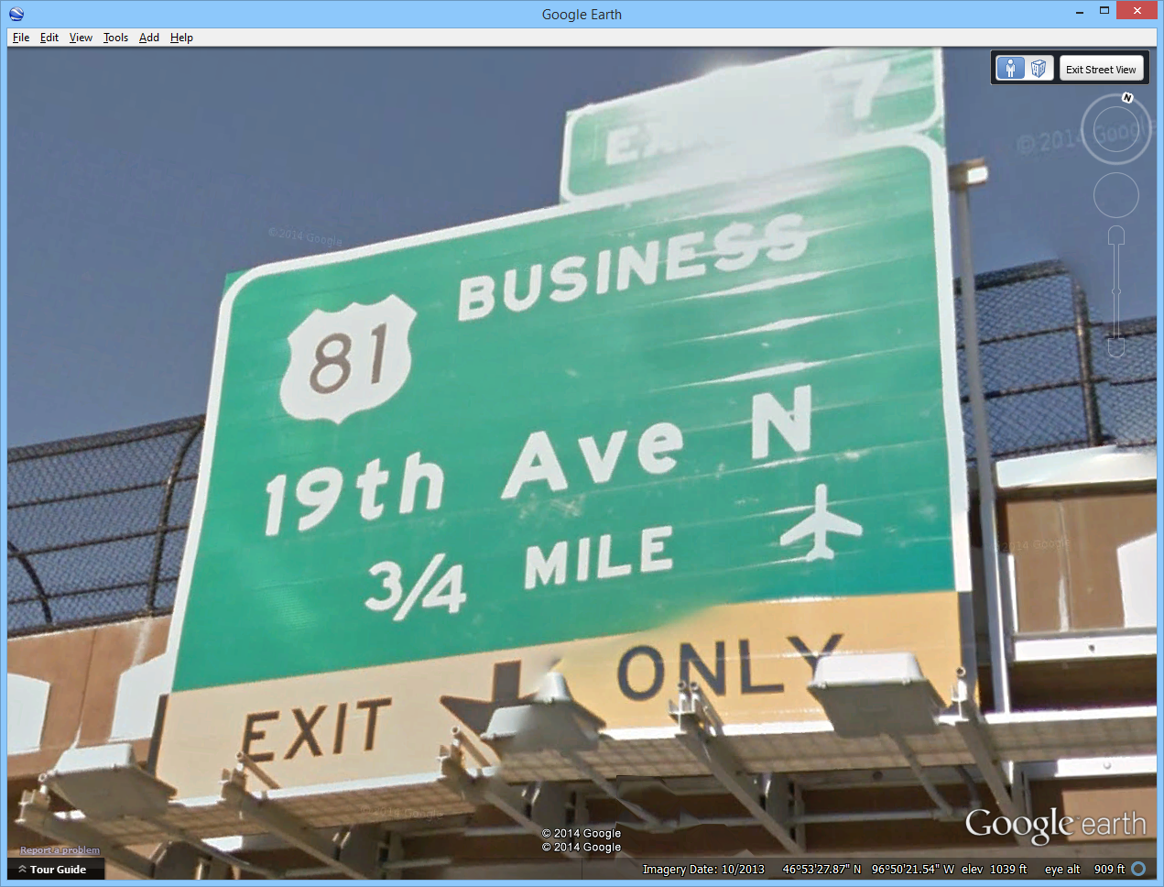
Power
All ITS sites need power
Most commonly gained from regional power company
Least cost is from existing service location
State offered power from existing drop
Nearby static sign
Notes:
Purpose of Slide: Present consideration for selection of power supply.
Key Message: Evaluation must be based upon the objectives that are trying to be achieved with the project.
Time on Chart: 3 minutes
Suggested Comments: ITS devices require electrical power to operate. As with the devices, the power design must support the user needs and requirements derived from the user needs. To accomplish the user needs, ITS devices need highly reliable power for continuous operation. Most commonly, power is obtained from a regional power company that does business with the system owner. Tying into the utility grid requires coordination with the utility and the services of an authorized Electrical Engineer to develop plans for approval. The biggest design drivers are installation cost, recurring costs, and reliability. For utility power, the most economical option is access to an electrical outlet in an existing cabinet. Capacity considerations, distance to the cabinet, and organizational considerations affect the ability and benefits of this approach.
Specialized applications can require additional devices to augment grid power. Applications to support emergency operations such as traffic surveillance along an evacuation route can demand high reliability operations for cameras and communications devices in the presence of extensive outages to the power and communication infrastructure. Operation of traffic control or traveler information devices can justify isolated operation support or outage reporting capability for shorter durations or localized power outages. Localized instability of grid power can justify conditioning equipment, even if protection against power outages is not necessary.
Using power sources outside of the utility grid should be considered when access to utility power requires significant investment.
Coordination with the state has been performed. The state not only approved the siting of the camera near the freeway, but has also offered to share the existing power drop used to light an existing static sign on the interchange overpass in exchange for access to the video stream. The existing riser is 100 feet from the desired camera pole, so the city has accepted the offer of power.
Transition:
Interactivity:
Additional Resources:

Slide 11
Power
Anticipated power budget
ITS DEVICE TYPE | MAX WATTAGE | EXPECTED WATTAGE | DUTY CYCLE | KWH/ YEAR | COST/ YEAR
Camera | 100 | 75 | 100% | 657 | $78.89
Ethernet Switch | 50 | 25 | 100% | 219 | $26.30
Light | 10 | 5 | 1% | 0 | $0.05
Ventilation | 10 | 7 | 10% | 6 | $0.74
Cabinet Monitor | 10 | 5 | 100% | 44 | $5.26
Convenience outlet | 200 | 200 | 1% | 18 | $2.10
Total | 380 | 317 |  | 945 | $113.34
Notes:
Purpose of Slide: Present anticipated power budget.
Key Message: A power budget will be required for most field installations.
Time on Chart: 1 minute
Suggested Comments: The power budget will be used to confirm the selection and sizing of power sources. For design purposes, the maximum draw is key information and should represent an upper limit of power required. The annual energy and cost is for budgetary estimate purposes for grid-connected systems. Isolated power needs require more analysis and accuracy.
Transition:
Interactivity:
Additional Resources:

Slide 12
Power
Communication design will introduce additional devices
Revised power budget
ITS DEVICE TYPE | MAX WATTAGE | EXPECTED WATTAGE | DUTY CYCLE | KWH/ YEAR | COST/ YEAR
Camera | 100 | 75 | 100% | 657 | $78.89
Ethernet Switch | 50 | 25 | 100% | 219 | $26.30
4G Router | 10 | 5 | 100% | 44 | $5.26
Strip Heater | 150 | 150 | 5% | 66 | $7.89
Light | 10 | 5 | 1% | 0 | $0.05
Ventilation | 10 | 7 | 10% | 6 | $0.74
Cabinet Monitor | 10 | 5 | 100% | 44 | $5.26
Convenience outlet | 200 | 200 | 1% | 18 | $2.10
Total | 540 | 472 |  | 1054 | $126.49
Notes:
Purpose of Slide: Present a revised power budget.
Key Message: A power budget may be revised based on results from other design decisions.
Time on Chart: 1 minute
Suggested Comments: In this example, two additional devices were required to implement the preferred communication approach using wireless Internet, including the 4G router and the cabinet strip heater. The additional power requirements related to these devices results in a modest (~10%) increase in expected energy usage, but a significant (~40%) increase in maximum power. Such an increase is significant, especially in attempting to use an existing power source.
Transition: The following slide presents potential answers for discussion questions.
Interactivity:
Additional Resources:

Slide 13
Power
Which components of the site should be powered by the Battery Backup System (BBS), if one was required?
BBS will support emergency operation on the short term
Camera surveillance can be very valuable
For short term, need camera, Ethernet switch, and 4G router
How would components of the site need to be revised if power came from a solar source?
Mounting of solar panels
Many factors in determining height, location, and orientation
Sufficient power storage
May need separate cabinet
Notes:
Purpose of Slide: Review the power questions.
Key Message: Review the power questions.
Time on Slide: 4 minutes
Suggested Comments:
Question 1:
For emergency operations, only the equipment directly providing transportation service should be included in the backup calculations. In this scenario, the camera, Ethernet switch, 4G router, and cabinet monitor will be carried on the BBS, while the ventilation, lighting, strip heater, and convenience outlet can be left unpowered if the grid power is unavailable.
Question 2:
Solar panels would need to be mounted and sufficient storage capacity to meet the power requirements would be needed. The sizing of the solar power source would depend on the average power draw and storage sizing would depend on the harshest power conditions required for supporting operations. With current technology, power storage is performed using batteries, but the battery technology (Lithium-ion, lead-acid AGM, sodium-sulfur, etc.) is undergoing significant active research, putting even general guidance on size and cost into flux. Consultation with a EE with experience in renewable energy and power storage is recommended. Typical requirements for powering equipment mandate that the system operate for a period of 7 days in the absence of any power input. With a power budget of ~2.5 kWh/day, a 7-day outage requirement would require energy storage of 17.5 kWh. The size of solar panels required to provide an average of 2.5 kWh/day is 40 – 80 square feet and is strongly dependent on environmental factors (geography, average cloud cover, vegetation, daylight hours) of a particular installation. If off-grid power is required and difficult to provide in sufficient quantity, revision to maximum allowable power for devices may be required, either by selection of more efficient equipment or operational policies to reduce the duty cycle.
Transition:
Interactivity: Ask class if they have any questions and encourage them to explain their answers.
Additional Resources:

Slide 14
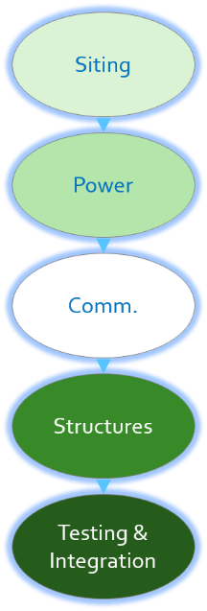
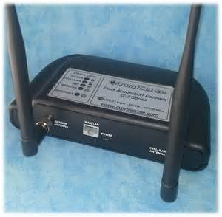
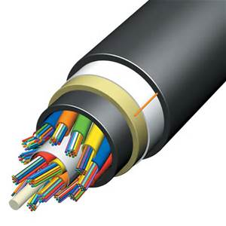
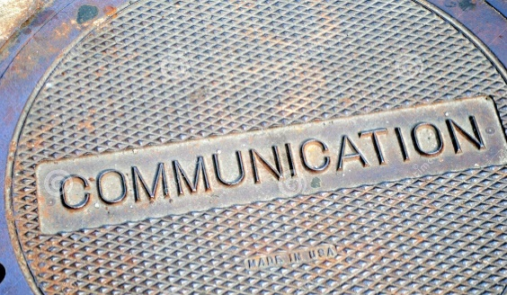
Communication
Specific plans required to access all locations with communication need
Extensive range of options available
Distance from existing infrastructure drives costs for wireline
“Last mile” may be different than trunk
Notes:
Purpose of Slide: Review options for communication from the field site to the user location.
Key Message: A wide variety of communication alternatives are available, but almost all now carry Ethernet data traffic.
Time on Chart: 2 minutes
Suggested Comments: The number of communication alternatives available continues to increase, with the cost and performance of the connection improving. No selection is correct for every location. A communication study can be useful for initial deployments or deployments outside of existing infrastructure.
As with power, the communication choices are driven by the user needs and requirements derived from the user needs. Several basic choices will constrain the selection. Some of the basic characteristics of communication selections include bandwidth, reliability, and security.
The initial determinations are the use of private or commercial infrastructure and wireless or wireline media. Frequently, installation cost is a major consideration, which will argue for use of either wireless communication alternatives or commercial alternatives. Depending on funding source, installation costs may be covered by grants or federal programs, while ongoing costs will be obtained from local operating budgets, which argue for owned infrastructure. The ability to reuse existing infrastructure can alter cost factors sufficiently to change final selection. Infrastructure to consider reusing includes conduit plant, cabling, cabinets, and structures.
Transition:
Interactivity:
Additional Resources:

Slide 15
Communication
Notes:
Purpose of Slide: Present options for communication from the field site to the user location.
Key Message: A wide variety of communication alternatives are available, but almost all now carry Ethernet data traffic.
Time on Chart: 3 minutes
Suggested Comments: For the exercise scenario, standard definition video at 30 frames per second requires about 500 kbps for acceptable appearance and up to 4 mbps for full resolution. The camera is located 2000’ from existing city communication infrastructure, which is copper multipair to the next intersection toward town. The options being considered are wireline using City infrastructure, a wireline/wireless hybrid using City infrastructure, Internet from the cable company, and wireless Internet from the local cellular provider. All of the following costs are accurate only in order of magnitude estimate.
For any wireline option, reaching between the camera location to the intersection is a $50K or greater prospect with much of the cost being installation of new underground conduit. With current technology, the preferred wireline alternative would probably be to reach from the camera to the intersection with fiber and then reach back to the Engineering Department at City Hall over two or three DSL hops on the legacy multipair. In order of magnitude, the electronics for the DSL upgrade would add another $10K.
Using a wireless hop to cover the camera to intersection segment would reduce the initial costs to about $3K, at the expense of some reliability and exposure to security issues. The City IT department has assessed security countermeasures and has determined the risks to be low and able to be isolated to the camera network.
Since the location is near the freeway and away from residential areas, the cable company does not have any infrastructure closer than the nearest intersection and no plans to expand in the area. They would charge the City for installation about the same $50K and then a $50/month fee for Internet data service.
The cellular provider has recently installed 4G data infrastructure that offers 5 mbps uplink and will offer the City an unlimited service option at $200/month.
With these options, the installation costs for the wireline options to the camera (options 1 and 3 above) are prohibitively expensive. The installation cost of the wireless hop to existing copper infrastructure exceeds that of the wireless cellular provider option by about 5 years of operational costs. The cellular option is requires the least planning work for at existing field locations. Furthermore, two years of service charges can be included in the project installation budget to limit operational cost impacts for the cellular option. The cellular option will be proposed as the preferred alternative for further analysis.
Transition: The following slide presents potential answers for discussion questions.
Interactivity:
Additional Resources:

Slide 16
Communication
How would your evaluation of the communication alternatives and siting alternatives change if the city installed fiber optic cable under the freeway concurrently with this project that passed 100 feet to the North of the arterial?
The same factors should be considered in light of the new development
Use unlicensed wireless Ethernet bridge from planned camera site to fiber access at signal cabinet.
If off-grid power requirements limit site duty cycle, how would communication requirements be altered?
Communication always available
Other devices including camera used on reduced schedule
Notes:
Purpose of Slide: Review the communication questions.
Key Message: Review the communication questions.
Time on Slide: 2 minutes
Suggested Comments:
Question 1:
The same factors should be considered in light of the new development:
- Quality of service.
- Installation cost.
- Recurring costs.
- Security.
A defensible decision would be to leave the camera at the selected site and place an Ethernet switch with fiber capability in the existing traffic signal cabinet, where the fiber could be directly spliced into. The distance from the camera to the cabinet would be handled with unlicensed wireless Ethernet bridge. Other solutions could include boring under the arterial to directly splice into the fiber, moving the camera to the North side of the arterial for easier access to the fiber, and negotiating with the city’s fiber designer to place the fiber on the South side of the arterial.
Question 2:
If periods are planned when the ITS devices would normally be off, the requirement for always-on communication should be maintained to allow for unscheduled or emergency operation. The 4G router and the Ethernet switch should be powered at all times. Other ITS devices can be scheduled to be powered off for portions of the day. A possible solution would be to control power using an Ethernet-enabled power strip or Power-over-Ethernet switch.
Transition:
Interactivity: Ask class if they have any questions and encourage them to explain their answers.
Additional Resources:

Slide 17
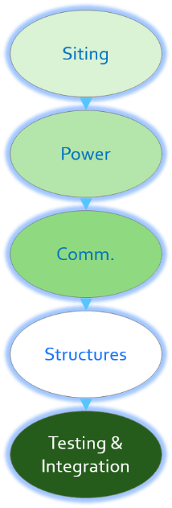
Mounting Structures
Existing structure
Major advantage is cost
New structure
Location
Soil condition
Protection from traffic
Height
Strength
Load of device
Load of cabinet
Cabinet mounting
Notes:
Purpose of Slide: Present alternatives for camera mounting.
Key Message: Review findings from the homework portion. Depending on timing and class size, several or all of the students could present their solutions.
Time on Chart: 1 minute
Suggested Comments:
Selection and design of mounting structure is dependent on costs and local preference. In some locations, cameras are mounted on existing structures, essentially eliminating mounting costs. Typical existing structures include traffic signal poles, communication towers, and city buildings such as parking decks and office roofs. Other locations require dedicated camera poles similar to roadway structures such as luminaires. For the exercise scenario, no existing structure is available, so we will be designing a 40 foot pole near the intersection overpass. A pole mount cabinet similar to a 336 cabinet will be used to house the camera and communication electronics. While a camera has not been selected, the weight has been specified as 15 pounds or less and the cross section at 300 square inches or less. The camera has to be operational in 90 mph winds and withstand 150 mph winds.
Transition:
Interactivity:
Additional Resources:

Slide 18
Mounting Structures
Notes:
Purpose of Slide: Present alternatives for camera mounting.
Key Message: Mounting of a camera is a traditional structure issue.
Time on Chart: 1 minute
Suggested Comments: Once a new camera pole has been selected as the mounting structure and a height has been determined, maintenance access to the camera becomes a major consideration. Typical alternatives for maintenance access include either lifting a technician to the camera or lowering a camera to the technician near street level, with bucket truck access being the most common for cameras up to 40 feet above ground and higher in locations with larger available equipment. Having the camera reach street level can be accomplished either by lowering the camera using a camera lowering device or using a pole that will tip down. The choice between these alternatives is driven by the height of the mounting and similar installed devices. For the desired siting at the example location, positioning a maintenance vehicle with a bucket of sufficient height to reach the camera would entail closure of the Eastbound to Northbound ramp, which is considered unacceptable by the state DOT. The height of the camera allows tip down poles and since tip down poles are approved in the jurisdiction, that is the selected approach. Had the camera been mounted significantly higher, the cost and feasibility of the tip down approach would have been less desirable and a camera lowering device would have been selected. The design shows foundation, conduit, mountings, and grounding for a sample solution using a folding pole tip down approach for use in Minnesota.
Transition: The next slide shows details of the tip down mechanism and pole mountings.
Interactivity:
Additional Resources:

Slide 19
Mounting Structures
Notes:
Purpose of Slide: Present alternatives for camera mounting.
Key Message: Selection of tip-down access requires unique design details.
Time on Chart: 1 minute
Suggested Comments: With the selection of the tip-down access, details related to the approach are required. In this example, the tipping is accomplished using a folding pole which has been designed. Details such as lowering mechanism and orientation, pole base mounting, mechanism maintenance access, and device mounting must be specified consistent with the requirements for safety and traffic impacts based on the details of the location. This slide shows a sample solution using a folding pole tip down approach for use in Minnesota.
Transition: The following slide presents potential answers for discussion questions.
Interactivity:
Additional Resources:

Slide 20
Mounting Structures
How would the design change if a BBS that weighed 40 lbs. was included in the cabinet?
Minimal change to foundation size for added weight and wind load
How would the design change if a solar power source was used for power that included 400 lbs. for solar power electronics and battery capacity? How would 27 square feet of solar panels be mounted?
Location requirements considered including
Height for orientation and vandalism resistance
Added weight
Wind loading
Possible separate structure
Notes:
Purpose of Slide: Review the structure questions.
Key Message: Review the structure questions.
Time on Slide: 2 minutes
Suggested Comments:
Question 1:
The additional loading would need to be accommodated in foundation size. This would probably result in minor changes, if any. Any conclusion with a valid rationale can be supported.
Question 2:
The biggest concerns would be the wind loading due to the solar panels and the required mounting height for solar orientation and resistance to vandalism. A separate structure to mount the solar panels and a separate cabinet for power electronics including batteries should be considered as an alternative.
Transition:
Interactivity: Ask class if they have any questions and encourage them to explain their answers.
Additional Resources:

Slide 21
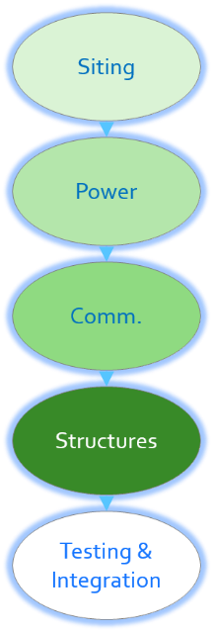
ITS Device Integration and Testing
Devices must operate to meet requirements
What characteristics are required to integrate with system?
System compatibility
Standards
Test plans need to be linked back to requirements
Testing should be incremental and progressive
Frequently test plans for each device and an integrated system test plan need to be developed to test all requirements
Notes:
Purpose of Slide: Introduce the topic of integration of devices into a system.
Key Message: ITS elements are of limited value in isolation.
Time on Chart: 2 minutes
Suggested Comments: While civil design does not have significant impact on the higher level goals of the project, devices and services need to be tested as working properly and prepared for integration into a system. Each capability required should be tested thoroughly, but once tested only needs to be reconfirmed with regression tests in more integrated settings. Preparation for testing is a part of the design process.
Transition: The following slides present potential answers for discussion questions.
Interactivity:
Additional Resources:

Slide 22
ITS Device Integration and Testing
Is there particular information that is most valuable for the test to be successful?
Test to camera requirements
Verify highest level need of delivering surveillance information
Notes:
Purpose of Slide: Review the testing questions.
Key Message: Review the testing questions.
Time on Slide: 2 minutes
Suggested Comments: The test needs to focus on requirements related to the details of the camera system in a detailed and comprehensive manner. The ability of the camera to supply quality images to end users is the highest level need that can be directly tested and should be a major component of the test.
Transition:
Interactivity: Ask class if they have any questions and encourage them to explain their answers.
Additional Resources:

Slide 23
ITS Device Integration and Testing
How would completion of the camera component relate to expected user needs of:
Reduced complaints from drivers and transit users!
This is addressed indirectly by supporting better performance of the roadway.
Better wayfinding
This is not addressed by this project.
Reduced delays/congestion
This is addressed indirectly by providing better information to traffic managers.
Reduced emissions and fuel consumption
This is addressed indirectly by supporting better performance of the roadway.
Safer driving environment
This is addressed indirectly by supporting better performance of the roadway.
Notes:
Purpose of Slide: Review the testing questions.
Key Message: Review the testing questions.
Time on Slide: 2 minutes
Suggested Comments: With the exception of the wayfinding need which is not addressed, these needs are addressed indirectly. The relationship between implementing the camera and addressing the user needs will have to be addressed in a project assessments. These user needs may need additional project components to be adequately satisfied.
Transition:
Interactivity: Ask class if they have any questions and encourage them to explain their answers.
Additional Resources:

Slide 24
ITS Device Integration and Testing
How would you involve the interested agencies, institutions, and organizations (shown in Table 8 of the exercise appendix) in the project development or project evaluation?
Camera implementation engages the City DOT and the State DOT
Invite others
Project planning sessions including goal setting
Demonstrations of completed implementation
Notes:
Purpose of Slide: Review the testing questions.
Key Message: Review the testing questions.
Time on Slide: 2 minutes
Suggested Comments: In this scenario, there needs to be coordination between the City DOT and the State DOT for the camera implementation. Year-one projects also involve the University Transit Department and the City Transit Authority. All should be involved starting as early in the project as possible and throughout the project. Stakeholders should be invited to participate in review of the component design, even though their involvement in the project components may be several years away. Stakeholders should also be invited to review results of the implementation upon completion. Stakeholder input should be considered as valuable guidance, but the control of the project including decisions on proceeding are retained by the City DOT.
Transition:
Interactivity: Ask class if they have any questions and encourage them to explain their answers.
Additional Resources:

Slide 25

Other Issues
Each agency will have a set of topics that must be addressed
Each customer and location will be unique
Use departmental checklists to assure coverage of topics
The community of contractors for each customer can provide needed support
Notes:
Purpose of Slide: Emphasize then need to address all of the projects design requirements.
Key Message: Most projects and locations requires planning beyond the basics of infrastructure design prior to being able to operate.
Time on Chart: 1 minute
Suggested Comments: This course has considered items routinely included in the process of preparing civil design elements for the implementation of infrastructure portions of a project. Most projects will additionally have considerations required that are unique to its location, jurisdiction, environment, technology, and design choices. Many jurisdictions use a checklist in the formal review. Reference to the checklist is a highly recommended practice during the project design and implementation.
In addition to items on the checklist, new issues may appear at any time during implementation.
Transition:
Interactivity:
Additional Resources:

Slide 26
Case Study Format and Purpose
Provide overview of civil design issues related to Intelligent Transportation Systems (ITS)
Explore approaches to integrating ITS components into field settings
Application: Design camera installation to support deployment of ITS for a major university trip generator – football game
Acceptable designs rely on interaction of engineering skills and project needs in the deployment location
Notes:
Purpose of Slide: Introduce purpose of the case study.
Key Message: This case study provides an overview of civil design supporting ITS.
Time on Chart: 1 minute
Suggested Comments: This case study has introduced you to civil design issues used to support Intelligent Transportation Systems (ITS) deployments. With each project that you support, you will gain experience that can assist in future projects that you execute or manage.
Transition:
Interactivity:
Additional Resources:

